Slide 1
Participation and gender dimension in the Neighbourhood Regeneration Programme, Chile
Viviana Fernández Prajoux
School of Archirecture, Faculty of Architecture and Urbanism, Department of Urbanism, University of Chile, Santiago, Chile
Bratislava, 25 September 2015
Second International Conference

Slide 2
SUMMARY
Since year 2000 Chile has initiated a process to strengthen the participatory and gender dimension as two cross-cutting issues in public management. The Neighbourhood Regeneration Programme was created and started as a participatory programme that has been gradually incorporating the gender approach in its implementation.
Structure of the presentation:
General description of the “Regeneration Programme”
Process of institutionalization of community participation and gender in public management,
Analyses of both dimensions within the programme,
Some reflections and conclusions.

Slide 3
CONTENT
1. General description of the “Regeneration Programme ”
The programme was one of the priority measures of the first government of President Michelle Bachellet (2006/2010).
The programme's goal was "to help improve the quality of life of the inhabitants of neighbourhoods that have problems of urban deterioration, segregation and social vulnerability”
Urban deterioration: urban segregation, deficit or deterioration of public space, infrastructure and / or collective amenities, degraded environmental image, connectivity and accessibility issues.
Social vulnerability: people with a low sense of belonging, a negative stigma, bad social relations, insecurity, concentration problems in areas such as education, recreation, culture and entrepreneurship.
Event Name

Slide 4
CONTENT
1. General description of the “Regeneration Programme”
MINVU: at two levels, national and regional, designing, financing and following up the implementation of the programme.
• The municipality: support and mediate between families and the consulting team
• The families of the neighbourhood and the organized community, especially the Neighbourhood Development Council, CVD.
Event Name

Slide 5
CONTENT
1. General description of the “Regeneration Programme ”
Since year 2011, the programme was institutionalized as part of MINVU programmes, and defines five cross-cutting themes to be reflected in all the products, both social and physical and must be part of the neighbourhoods working plan during all stages.
These themes are: Citizen Participation, Identity and Cultural Heritage, Environment, Citizen Security and Digital Connectivity.
The neighbourhood team is composed of three professionals: the coordinator of the neighbourhood and all those directly involved, a Social manager and an Urban manager.
Event Name

Slide 6
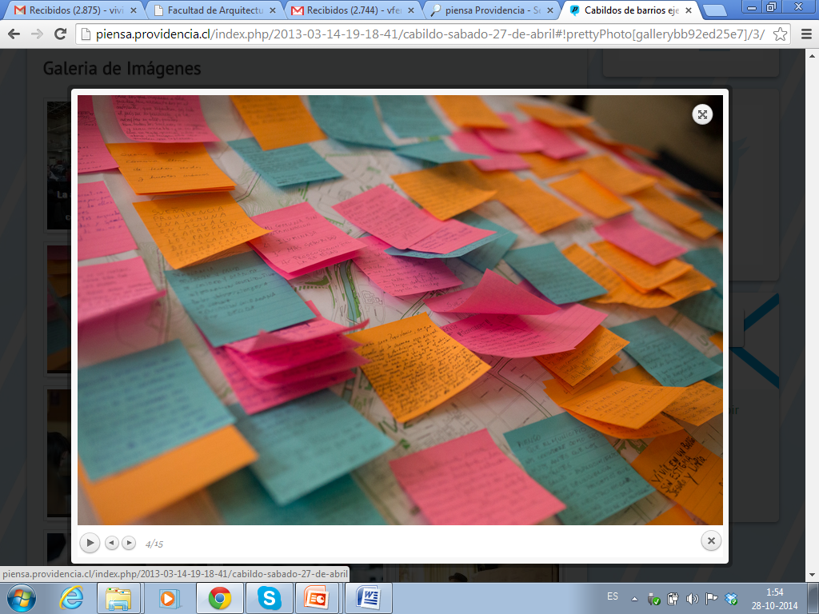
CONTENT
2. Process of institutionalization of citizen participation and gender in public administration
In 2006, the Agenda Pro Participation, was launched with the purpose of guarantee people´s right to participate in their policies, plans and programmes “We have a democratic urgency, as a country, to provide institutional spaces for citizen participation in public affairs (Bachelet, 2006)“
In 2008, a Law promoting transparency and Information was put in practice.
In 2011, the Participation Act, was finally adopted, saying that all government institutions must define their modalities of participation and make available to citizens the relevant information on time, being accountable and setting the issues on which necessarily the views of citizens must be considered.
In 2014, a new Presidential Instructive for citizen participation in public management.
Event Name

Slide 7
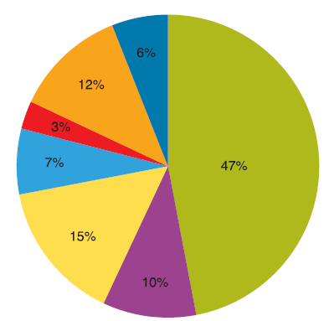
CONTENT
2. Process of institutionalization of citizen participation and gender in public administration
Since 1998, within the framework of State Modernization, the Improvement Programmes of Public Management, PMG were initiated.
The Gender PMG, was one of the system implemented. All public institutions should formulate gender goals in relation to their main products or services.
2011, one of the goals of the MINVU Work Plan arises in relation to the Regeneration Programme that the community involved in the regeneration process of their neighbourhoods should identify their different needs (men and women) in the use and appropriation of the public spaces of the neighbourhood.
2014, Agenda for Gender Equity and Equality between Women and Men: a guiding principle and goal of all public policies and private public affairs.
Different family structure
Event Name

Slide 8
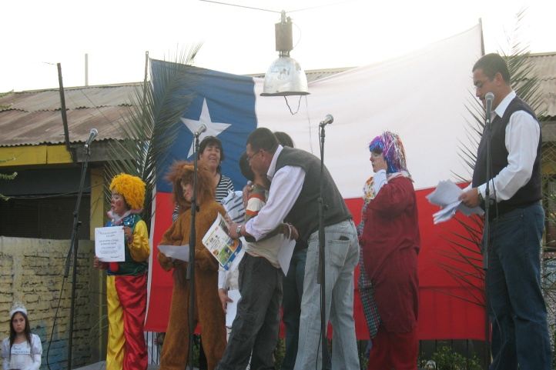
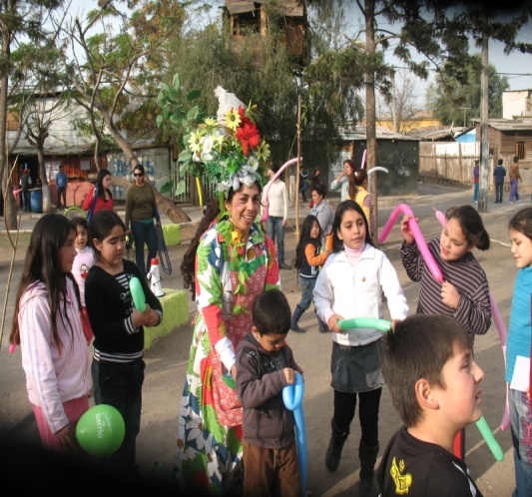
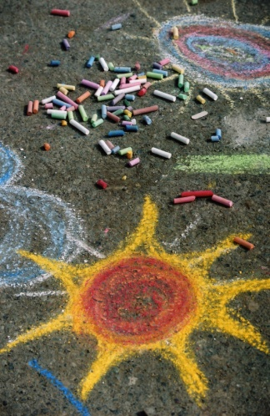
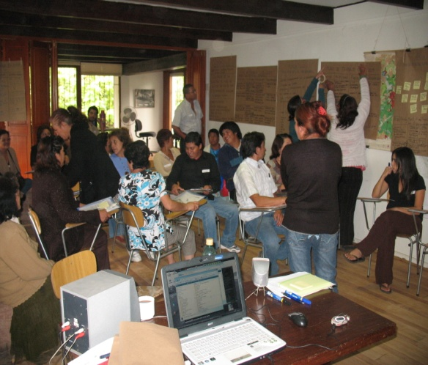
3. Participation and Gender in the Regeneration Programme
The analysis comes from various actions and investigations:
Coordination of Phase II and III in the Santa Rosa de Lima Neighbourhood in the municipality of San Bernardo (2008-2009)
PhD. thesis in participatory planning in local government
Consultant on gender issues for various public institutions, in some assessing gender projects.

Slide 9
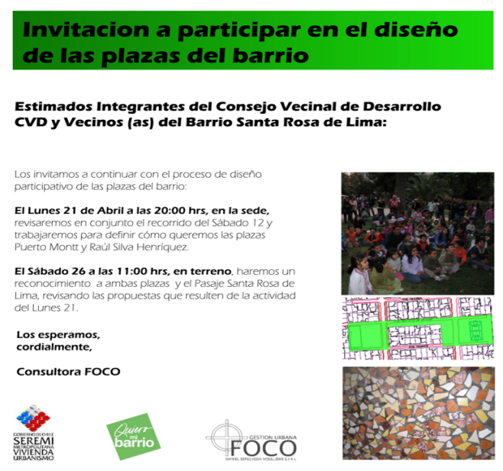
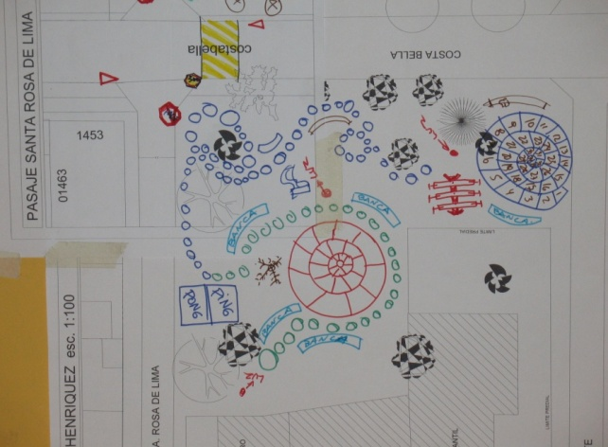
3. Participation and Gender in the Regeneration Programme
a) Institutionalizing participation and gender
the institutionalization of community participation and gender in the programme has been less smooth than expected and not without difficulties of various kinds. The Participatory Act and Gender Agenda still has no regulations for its implementation, monitoring and control.
The programme need a more wider debate regarding the conceptualisation of participation or what kind of participation is expected to be developed during the different phases of the programme and in the case of gender is more related with the implementation more than the conceptualisation. In my experience in the pilot programme, the development of the participatory process was more intuitive than reflective, was designed based on experiences and team discussions, was basically a process of “learning by doing”.

Slide 10
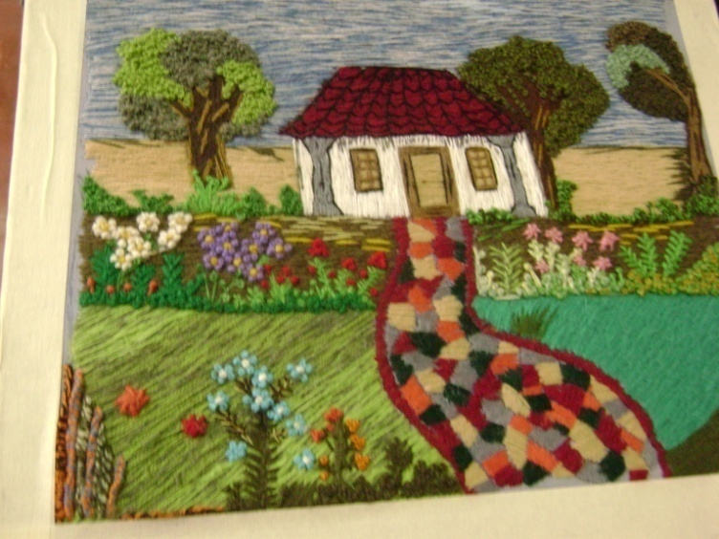
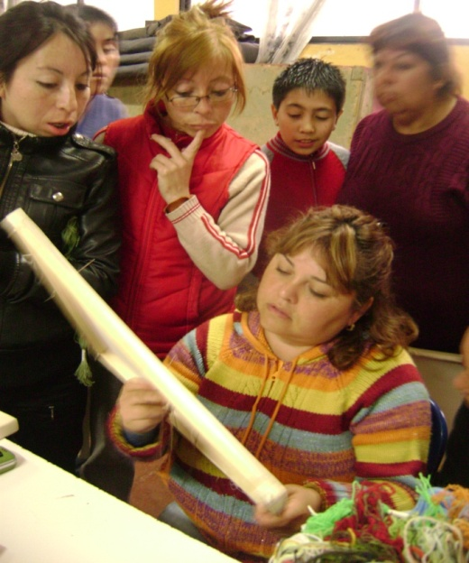
3. Participation and Gender in the Regeneration Programme
b) the duration of the intervention process in the neighbourhoods,
One common aspect to both dimensions that directly affect their application in the programme is the time factor. The duration of the programme (around 36 months) and the specific requirements of the programme (progress reports) make it difficult for neighbourhood teams to spend some time sharing experiences or reflecting on how to make an effective participation or incorporate a gender approach in their activities. For the same reason they also have little time to evaluate projects or add new dimensions and approaches to urban and social practice.
Most time Gender is just seen as women project

Slide 11
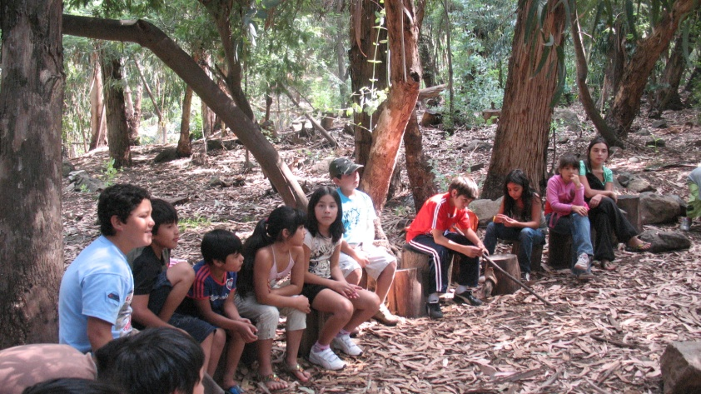
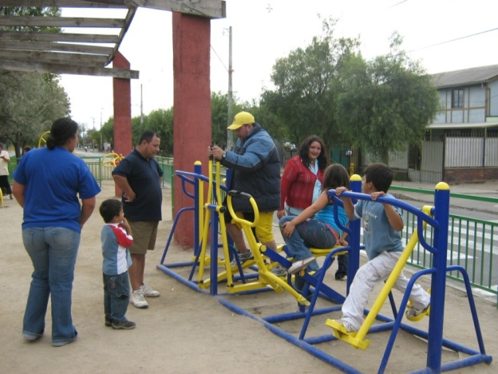
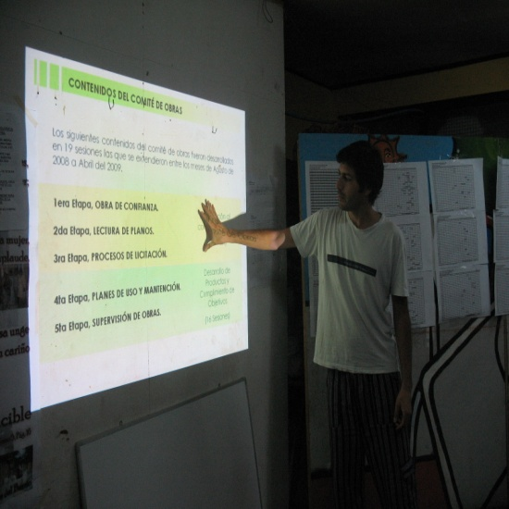
3. Participation and Gender in the Regeneration Programme
c) the neighbourhood team in charge of developing the programme,
Participation and gender are more social issues so most urban team don´t have this knowledge or experience.
Rotation of professionals, they do not always remain throughout the process, (location of the neighbourhoods is distant from the city centre, wages are not the best or the work does not meet their expectations).
So often the training and reflections meetings must be repeated to update the new professionals and the experience of those who have left will be lost.

Slide 12
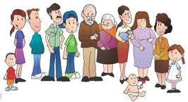
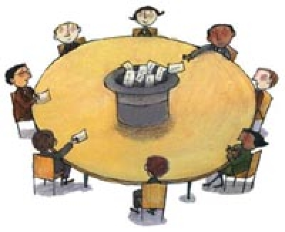
3. Participation and Gender in the Regeneration Programme
d) methodological tools developed by the programme for its implementation
They are quite descriptive, they are not too explicit or suggest methodologies to incorporate the gender approach. The instruments for diagnosis (perception survey neighbours, workshops and neighbourhood tours, etc.) indicate in detail the instrument (objectives, timelines, actors, etc.), but not explicit methodologies,
In both cases to promote an effective participatory process and to ensure a gender representation. will depend on the neighbourhood team so if their knowledge is not enough the result won´t be successful. While the profile of the professional required of all this knowledge and experience the neighbourhood team not always are the most qualified professionals for the skills they need.

Slide 13
CONCLUSIONS
4. Reflections and conclusions
Although today participatory and gender-sensitive approaches seem not be in dispute, the point is how we can make that this new dimensions to be effectively implemented.
With the last presidential instructions of last year, it is possible that today every government institution has create their Participation Units, but they have inform or debate with the different programmes they must implement?
We clearly need a real political will of public authorities and their managers and technical teams. This means having clear that this participatory process with a gender perspective has different time frames.
We must begin to implement a process of true institutionalization of these new practices (participation and gender), not as an addition to the usual management administration, but as dimensions inherent to it..
Also it is necessary to allocate resources and time to conceptualize, gather and share experiences that will help and collaborate with the teams responsible for implementing these new approaches.
We need to introduce this issues to our students, concepts and practice
Event Name

Slide 14
If you would like more information about the content of this presentation please contact:
Viviana Fernández Prajoux
vfernand@uchilefau.cl
or visit our web site
www.oikonet.org
This project is funded with support from the European Commission (Project number 539369-LLP1-2013-1-ES-ERASMUS). This publication reflects the views only of the authors, and the Commission cannot be held responsible for any use which may be made of the information contained therein.

